Slide 1
UCP 0010 – Research Methodology 30th March 2014
MODULE 4
RESEARCH METHODOLOGY AND DESIGN
Professor Dr Naomie Salim
Department of Information Systems
Faculty of Computing
Universiti Teknologi Malaysia

Slide 2
Learning Outcome
Identify and design suitable techniques/methodology for the proposed research

Slide 3

Research Design
“Having decided WHAT you want to study ABOUT, the next question is, HOW are you going to conduct your study?”
What procedures will you adopt to answer your research questions?
How to carry out tasks needed to solve components of your research process?
What should you DO and NOT DO in undertaking the study?
RESEARCH DESIGN/ METHODOLOGY

Slide 4
Qualitative vs. Quantitative
Quantitative researchers
The results of research is quantified (use numbers)
generates statistics through the use of large-scale survey research, using methods such as questionnaires or structured interviews as well as experiments
Qualitative research
means "any kind of research that produces findings without using statistical procedures or other means of quantification".
explores human behavior and reasons that govern such behavior. The qualitative method investigates the why and how of decision making, not just what, where, when. Hence, smaller but focused samples are more often needed, rather than large samples.

Slide 5
Quantitative vs. Qualitative Research
Quantitative | Qualitative
Theory-testing | Theory-generating
Objective - seeks precise measurement & analysis of target concepts, e.g., uses surveys, questionnaires etc. | Subjective - individuals’ interpretation of events is important ,e.g., uses participant observation, in-depth interviews etc.
Focus on variables | Focus on interactive processes, events, themes, motives, generalizations and taxonomies
Measures systematically created prior data collection and are standardized | Measures created in an ad hoc manner and usually specific to the context
Data are in the form of numbers from precise measurement | Data are in the form of words and images from documents observations and transcripts
Procedures are standard, and replication is assumed | Research procedures are particular and replication is very rare

Slide 6
Epistemology
Theoretical Perspective
Methodology
Method
(Crotty, 1998)

Slide 7
Epistemology – the theory of knowledge embedded in the theoretical perspective and thereby in the methodology
Theoretical perspective – the philosophical stance informing the methodology and thus providing a context for the process and grounding its logic and criteria
(Crotty, 1998)

Slide 8
Methodology – the strategy, plan of action, process or design lying behind the choice and use of particular methods and linking the choice and use of method to the desired outcomes
Methods – the techniques or procedures used to gather and analyse data related to some research questions or hypotheses
(Crotty, 1998)

Slide 9
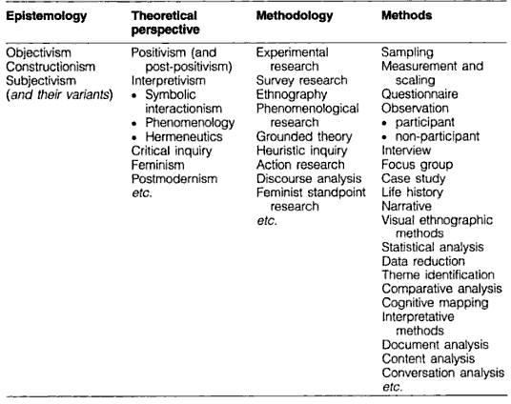
(Crotty, 1998:5)

Slide 10
Objectivism vs. Subjectivism
Objectivism | Subjectivism
Single reality | Multiple reality
Deductive | Inductive
Relationships among variables | Descriptions of situations
Researcher is detached | Researchers is a tool
Context-free generalisation | Context-bound descriptions
Generalisation is the responsibility of the researcher | Generalisation / Transferability is determined by readers

Slide 11
Why all the -isms?
Regardless of whether investigators identify the philosophical traditions from which their research questions emerge, all research is comprised of at least one set of philosophical beliefs about the nature of research and the purpose of scientific investigation.
(Thorkildsen, 2005)

Slide 12
John Creswell (2008)
Postposivitism | Constructivism
Determination Reductionism Empirical observation & measurement Theory verification | Understanding Multiple participant meanings Social & historical construction Theory generation
Advocacy/Participatory | Pragmatism
Political Empowerment Issue-oriented Collaborative Change-oriented | Consequences of actions Problem-centered Pluralistic Real-world practice oriented

Slide 13
Postpositivism
Knowledge is conjectural – absolute truth can never be found
Research is the process of making claims and then refining or abandoning some of them for other claims more strongly warranted
Data, evidence & rational considerations shape knowledge
Research seeks causal relationships
Need to be objective & unbias
(Creswell, 2008)

Slide 14
Constructivism
Meanings are constructed by human beings as they engage with the world they are interpreting
Humans make sense of the world based on historical, social and cultural perspectives
Research is to generate meanings from data
(Creswell, 2008)

Slide 15
Advocacy / Participatory
Focus on bringing about change in practices
Helping individuals and especially minority to free themselves from injustice
To empower the minorities
Research focuses on collaboration and engagement
(Creswell, 2008)

Slide 16
Pragmatism
The world is not an absolute unity
Not committed to any one system of philosophy and reality
Freedom to choose
Truth that works at the time
Not much on questioning and debating but more on actions
Anything that works
(Creswell, 2008)

Slide 17
Philosophy
Philosophy | Brief Definition
Postpositivism | The highest form of knowledge is assumed to be a description of sensory phenomena. Truth about reality serves as a regulative ideal to strive for, but is unlikely to be defined
Pragmatism | The meaning of ideas is assumed to be the same as the practical effects of adopting those ideas and putting them into practice
Empiricism | Knowledge is tied directly to sensory contents of consciousness or to other expressed classes of experience. Other form of knowledge are assumed to be nonexistenct
Rationalism | Unaided reason can lead to the acquisition and justification of knowledge and is preferred over sensory experience
Relativism | Turth is assumed to be in the eye of the beholder and there can be no universal understading of reality

Slide 18
Theory
Theory | Brief Description
Behaviourism | Study behaviour and its causes
Critical theory | Label the effects of power hierachies and subjective experience during particular historical periods
Ethnographic theory | Study cultures and how individuals’ behaviour is regulated by their environment
Hermeneutic theory | Construct theories such that one element can only be understood in terms of the meaning of others or the whole
Linguistic theory | Study language and its role in communication
Personality theory | Explore individuals’ characteristics and the phenomena of personhood
Social-cognitive theory | Study psychological functioning in social contexts
Symbolic interactionism | Question how symbols and understandings give meaning to human interactions
System theory | Identify how people and contexts reflect different levels of a common system

Slide 19
Eg. Understanding Plagiarism
Your theoretical assumption | Your focus
Behaviourism | How can plagiarism be reduced?
Critical theory | Who has the power in deciding the level of plagiarism and who is oppressed?
Ethnographic theory | How is plagiarism varied across different cultures?
Hermeneutic theory | At FC, how do lecturers and students make meaning out of ethics in academic writing?
Linguistic theory | How do different languages affect the level of plagiarism?
Personality theory | What are the characteristics of the students who commit high level of plagiarism?
Social-cognitive theory | How does students’ engagement in FC affect their pactice of plagiarism?
Symbolic interactionism | What do the scores on Turn-it-in symbolise and how do people interpret them?
Systems theory | How does the combination of a person’s environment, personality, social-cognitive abilities and intelligence affect the tendency to plagiarise?

Slide 20
Methodologies
Grounded Theory
Ethnography
Action Research
Case Study
Formal
Mathematical
Simulation
Experimental
Build
Process
Model

Slide 21
Grounded Theory
Glaser and Strauss (1967) and their work on the interactions between health care professionals and dying patients.
Development of new theory through the collection and analysis of data about a phenomenon.
The explanations that emerge are genuinely new knowledge and are used to develop new theories about a phenomenon.

Slide 22
Grounded Theory
GT is one that will fit a situation being researched, and will work when put into use.
Fit - the categories generated through research must be readily (not forcibly) applicable to and indicated by the data under study.
Work - those categories must be meaningfully relevant to and be able to explain the behaviour under study

Slide 23
Grounded Theory
Five premises underlying GT:
The analysis of data is a ‘pragmatic’ one, guidelines and rules of thumb
Analysis → generating new concepts/theories.
‘grounded’ in empirical - ‘constant comparison’
‘open-mind’
‘theoretical’ sampling

Slide 24
Grounded Theory
Constant comparative method is the comparing of (Glaser, 1978):
different people
data from the same individuals with themselves at different points in time
incident with incident
data with category
a category with other categories

Slide 25
Grounded Theory
There are a few stages of data coding:
open-coding
axial-coding
selective-coding
(Strauss & Corbin, 2008)

Slide 26
Grounded Theory
The process of research will involve the continual selection of units until the research arrives at the point of theoretical saturation.
It is only when new data seems to fit the analysis without further modifications of the emerging theory, rather than add anything new, that the theory is saturated and the sample size is ‘enough’.

Slide 27
Grounded Theory
The categories developed through this process evolve as the researcher gain more theoretical sensitivity.
Make memos
Keep going back to the data & theoretical samples
Until hypotheses / themes / theories emerge

Slide 28
Grounded Theory
Bryant, A. & Charmaz, K. (2007). The Sage handbook of grounded theory. London: Sage.
Charmaz, K. (2003). Grounded theory: objectivist and constructivist methods. In N. K. Denzin & Y. S. Lincoln (ed.) Strategies of qualitative inquiry. (2nd ed.) (pp.249-291). Thousand Oaks: Sage Publications.
Charmaz, K. (2005). Grounded theory in the 21st century: applications for advancing social justice studies. In N. K. Denzin & Y. S. Lincoln (Ed.) The Sage handbook of qualitative research. (3rd ed.) (pp.507-536). Thousand Oaks: Sage Publications.
Glaser, B. G. & Strauss, A. L. (1967). The discovery of grounded theory – Strategies for qualitative research. London: Weidenfeld and Nicolson.
Glaser, B. G. (1978). Advances in the methodology of grounded theory: theoretical sensitivity. San Francisco: Sociology Press.
Glaser, B. G. (1992). Basic of grounded theory analysis: emergence versus forcing. Mill Valley, California: Sociology Press.
Glaser, B. G. (1998). Doing grounded theory: issues and discussion. California: Sociology Press.
Strauss, A. L. & Corbin, J. M. (2008). Basic of qualitative research: Grounded theory procedures and techniques. (e ed.). Thousand Oaks: Sage Publications, Inc.

Slide 29
Ethnography
Has a background in anthropology.
“portrait of a people”
for descriptive studies of cultures & peoples.
The cultural parameter - the people under investigation have something in common - geographical, religious, tribal, shared experience

Slide 30
Ethnography
often interviewing individuals on several occasions, and participant observation.
extremely time consuming - spending long periods of time in the field.

Slide 31
Ethnography
Analysis of data adopts an “emic” approach - interpret data from the perspective of the population under study.
The results are expressed as though they were being expressed by the subjects themselves
often using local language and terminology to describe phenomena – problematic if not familiar with the social or language

Slide 32
Ethnography
Interpretation from an “etic” perspective - an outsider perspective - may be a misinterpretation causing confusion.
ethnographic researcher usually returns to the field to check the interpretations with informants
validating the data before presenting the findings

Slide 33
Ethnography
Alexander, B. K. (2005). Performance ethnography: The reenacting and inciting of culture. In. N. K. Denzin & Lincoln, Y. S. (eds.). The Sage handbook of qualitative research (3rd ed.) (pp.411-442). Thousand Oaks: Sage.
Atkinson, P. A. (1990). The ethnographic imagination. London: Routledge.
Delamont, S. (2004). Ethnography and participant observation. In C. Seale, Gobo, G., Gubrium, J. F. & Silverman, D. (eds.) Qualitative research practice (pp.217-229). London: Sage.
Fetterman, D.M. (1989). Ethnography: Step by step, Newbury Park, Sage Publications.
Hammersley, M. & Atkinson, P. A. (1995). Ethnography: Principles and practice (2nd ed.). London: Routledge.

Slide 34
Action Research
a subset of participant observation
the participants (practitioners) in some focused change effort (to change something) self-reflect on their experiences in order to improve practice for themselves or an organization.

Slide 35
Action Research
It is a flexible spiral process which allows action (change, improvement) and research (understanding, knowledge) to be achieved at the same time
involve the individuals affected by the change, thus allowing the understanding to be widely shared and the change to be pursued with commitment.

Slide 36
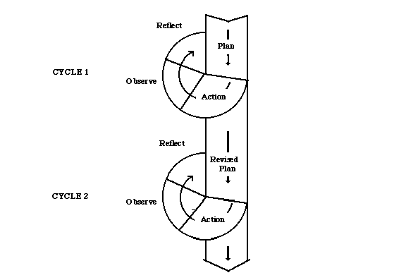
Action Research
Reflection phase - observations are interpreted and shared so that the issue or problem can be better understood.
Planning phase - actions are proposed to address the issue or problem.
Action phase - the plan is implemented and the cycle starts again as outcomes are observed, recorded, and shared.
Observation phase - the issue or problem is monitored and described. Useful data is recorded and kept.

Slide 37
Action Research
Elliott, J. (1991). Action research for educational change. Milton Keynes: Open University Press.
Greenwood, D. J. & Levin, M. (2005). Reform of the social sciences and of universities through action research. In. N. K. Denzin & Lincoln, Y. S. (eds.) The Sage handbook of qualitative research (3rd ed.) (pp. 43-64). Thousand Oaks: Sage.
Ladkin, D. (2004). Action research. In C. Seale, Gobo, G., Gubrium, J. F. & Silverman, D. (eds.) Qualitative research practice (pp.536-548). London: Sage.
Winter, R. (1989). Learning from experience: Principles and practice in action research. London: Falmer Press.

Slide 38
Case Study
Emphasize detailed contextual analysis of a limited number of events or conditions and their relationships.
The value of case study relates to the in depth analysis of a single/small number of units.
Case study research is used to describe an entity that forms a single unit such as a person, an organisation or an institution.
Can describe a series of cases.

Slide 39
Case Study
It offers a richness and depth of information not usually offered by other methods.
Can identify how a complex set of circumstances come together to produce a particular manifestation.
It is a highly versatile research method and employs any and all methods of data collection from testing to interviewing.

Slide 40
Case Study
Generalisability is not normally as issue for the researcher
It is an issue for the readers who want to know whether the findings can be applied elsewhere.
The readers must decide whether or not the case being described is sufficiently representative or similar to their own local situation.

Slide 41
Case Study
Six steps to be used:
Determine and define the research questions
Select the cases and determine data gathering and analysis techniques
Prepare to collect the data
Collect data in the field
Evaluate and analyze the data
Prepare the report

Slide 42
Case Study
Flyvbjerg, B. (2004). Five misunderstandings about case-study research. In C. Seale, Gobo, G., Gubrium, J. F. & Silverman, D. (eds.) Qualitative research practice (pp.420-434). London: Sage.
Stake, R. E. (2005). Qualitative case studies. In. N. K. Denzin & Lincoln, Y. S. (eds.) The Sage handbook of qualitative research (3rd ed.) (pp.443-466). Thousand Oaks: Sage.

Slide 43
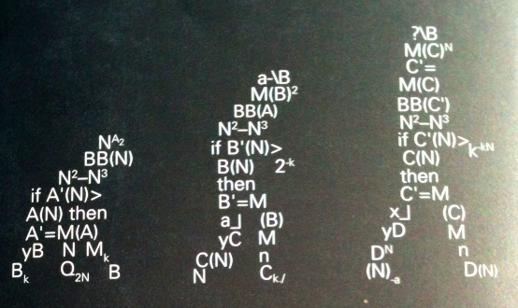
Formal Methods
(Amaral, J., About Computing Science Research Methodology)
Formal
Used to prove facts about algorithms
Skills needed:
problem-solving, mathematical proof techniques, algorithms design and analysis, complexity theory
Example:
Formal specification of a software component
Time or space complexity of an algorithm
Correctness or the quality of the solutions generated by the algorithm

Slide 44
Mathematical Modeling
Performs the problem abstraction, when different properties of a system are defined using a set of parameters and interactions of these properties are defined with functions over the parameters.
Mathematical modeling provides a set of features, it allows to
investigate properties of the whole system, based on a subset of measured parameters.
see the system’s asymptotic behavior.
find optimal conditions for a system.

Slide 45
Modeling
(Amaral, J., About Computing Science Research Methodology)
Model
Centered on defining an abstract model for a real system
Use a model to perform experiments that could not be performed in the system itself because of cost or accessibility, thus the model developed is an instrument used by researchers to study the research ‘s object.
Experiments based on a model can also be simulations (may use simulation tools to evaluate the proposed solution)

Slide 46
Computer Simulation
When a small sample program representing the studying algorithm/protocol is created for an existing toolkit (or seldom from the scratch), which simulates the real work or practice.
Computer Simulation allows to
produce “cheap” evaluation research.
do research, when the development time is crucial.
do research, when the sources (money, number of devices) are limited.
do research even in the black-box architecture, real development is limited.

Slide 47
Build
(Amaral, J., About Computing Science Research Methodology)
Build
Build an artifact, either a physical artifact or a software system, to demonstrate that it is possible
To be considered research, the construction of the artifact must be new or it must include new features that have not been demonstrated before
Need to compare the functionality and/or performance of the system with existing systems to verify the claim

Slide 48
Software development
Software development is a part of the research, when a product-like software (demo) is produced. Sometimes it is even in the form of commercial product, i.e., this methods allows to show that the research idea is fully feasible.
Software development allows to:
create a proof-of-concept.
see design errors/pitfalls in the idea.
produce the research with most realistic environment

Slide 49
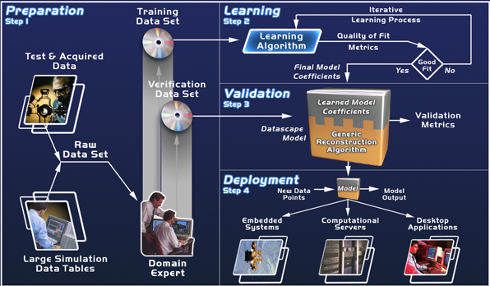
Process
(Amaral, J., About Computing Science Research Methodology)
Process
Used to understand the processes used to accomplish tasks in Computing Science.
Most useful in the study of activities that involve humans
Mostly used in the areas of Software Engineering and Man-Machine Interface

Slide 50
Business methods
Business research methods are the research methods examines computing from the business point of view.
Business methods allows to
study commercialization of the research.
focus on the factors affecting the commercial success.
predict future trends of the research and industry.

Slide 51
Experimental
(Amaral, J., About Computing Science Research Methodology)
Experimental
Use to evaluate new solutions for problems
Need to identify:
List of questions what the experiment is expected to answer
what are the performance measure to evaluate the solution in order to answer the research question
Design the experiment
Experimental research allows to
produce a research even in case if the modeling is difficult.
acquire result, when a simulation may be a very slow process.
see non-trivial dependencies between parameters.

Slide 52
Experiment Design
Experiment design is the process of deciding which variables to use, what tasks and procedure to use, how many participants to use or data to use, and how to solicit them, how to pre-process data and so on
Let’s work on the terminology…

Slide 53
Experiment Design - Terminology
Terms to know
Participant
Independent variable (test conditions)
Dependent variable
Control variable
Random variable
Confounding variable

Slide 54
Participant
The people participating in an experiment are referred to as participants
Previously the term subjects was used, but it is no longer in vogue
When referring specifically to the experiment, use the term participants (e.g., “all participants exhibited a high error rate…”)
General comments on the problem or conclusions drawn may use other terms (e.g., “these results suggest that users are less likely to…”)
Report the selection criteria and give relevant demographic information or prior experience

Slide 55
How Many Participants?
The Answer: It depends!
Too many:
Results are statistically significant, even where the differences are miniscule and of no practical relevance
Too few:
Results are not statistically significant (because of the small sample size), even though there maybe a significant difference in the test conditions (“significant” in the practical sense)
Guideline:
Use approximately the same number of participants as in other similar research †
† Martin, D. W. (2004). Doing psychology experiments (6th ed.). Belmont, CA: Wadsworth.

Slide 56
Independent Variable
An independent variable is a variable that is manipulated through the design of the experiment
It is “independent” because it is independent of participant behaviour (i.e., there is nothing a participant can do to influence an independent variable)
Examples include interface, device, feedback mode, button layout, visual layout, gender, age, expertise, etc.
The terms independent variable and factor are synonymous

Slide 57
Test Conditions
The levels, values, or settings for an independent variable are the test conditions
Provide a name for both the factor (independent variable) and its levels (test conditions)
Examples
Factor Test Conditions (Levels)
Device mouse, trackball, joystick
Feedback mode audio, tactile, none
Task pointing, dragging
Visualization 2D, 3D, animated
Search interface Google, custom

Slide 58
Dependent Variable
A dependent variable is a variable representing the measurements or observations on a independent variable
Examples include task completion time, speed, accuracy, error rate, throughput, target re-entries, retries, key actions, etc.
Give a name to the dependent variable, separate from its units (e.g., “Text Entry Speed” is a dependent variable with units “words per minute”)

Slide 59
Three “Other” Variables
Important but usually given less attention are
Control variables
Random variables
Confounding variables

Slide 60
Control Variable
Circumstances or factors that (a) might influence a dependent variable, but (b) are not under investigation need to be accommodated in some manner
One way is to control them – to treat them as control variables
E.g., room lighting, background noise, temperature
The disadvantage to having too many control variables is that the experiment becomes less generalizable (i.e., less applicable to other situations)

Slide 61
Random Variable
Instead of controlling all circumstances or factors, some might be allowed to vary randomly
Such circumstances are random variables
More variability is introduced in the measures (that’s bad!), but the results are more generalizable (that’s good!)

Slide 62
Confounding Variable
Extraneous variable that correlates (directly or inversely) with both the dependent variable and the independent variable.
A perceived relationship between an independent variable and a dependent variable that has been misestimated due to the failure to account for a confounding factor
Eg. statistical relationship between ice-cream consumption and number of drowning deaths for a given period.
These two variables have a positive correlation with each other.
An evaluator might attempt to explain this correlation by inferring a causal relationship between the two variables (either that ice-cream causes drowning, or that drowning causes ice-cream consumption).
However, a more likely explanation is that the relationship between ice-cream consumption and drowning is spurious and that a third, confounding, variable (the season) influences both variables: during the summer, warmer temperatures lead to increased ice-cream consumption as well as more people swimming and thus more drowning deaths

Slide 63
Confounding Variable
Any variable that varies systematically with an independent variable is also a confounding variable
Example 1 – three techniques are compared (A, B, C)
All participants are tested on A, followed by B, followed by C
Performance might improve due to practice
“Practice” is a confounding variable (because it varies systematically with “technique”)
Example 2 – two search engine interfaces are compared (Google vs. new)
All participants have prior experience with Google, but no experience with the new interface
“Prior experience” is a confounding variable

Slide 64
Research designs differ in
The amount the researcher manipulates the independent variables
Controls for confounding variables
Degree of internal validity

Slide 65
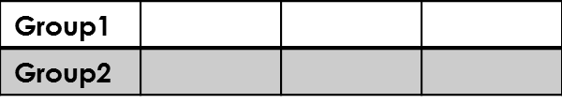
Experimental and Ex post Facto Design
How to illustrate these various designs?
Tx indicates Treatment( Independent Variable)
Obs indicates Observation( Dependent Variable)
Exp indicates previous Experience( Independent Variable) Some participants have had, researcher can not control
Group Time

Slide 66
Pre-Experimental Designs

Slide 67
Pre-Experimental Designs
One-Shot experimental Case study
Group Time
Most primitive type
Impossible to know if the situation has changed
Exposure to cold(Tx) Child has a cold(Obs)
Group1 | Tx | Obs

Slide 68
Pre-Experimental Designs
One-Group Pretest-Posttest Design
Group Time
We at least know that a change has taken place
Group1 | Obs | Tx | Obs

Slide 69
Pre-Experimental Designs
Static Group Comparison
Group Time
Involves both an experimental group and a control group
No attempt to obtain equivalent groups
No attempt to examine the groups to determine whether they are similar
No way of knowing if the treatment causes any difference between groups
Group1 | Tx | Obs
Group2 | ---- | Obs

Slide 70
True Experimental Designs
Importance of Randomness

Slide 71
True Experimental Designs
Pretest-Posttest Control Group Design
Group Time
Experimental and Control groups are selected randomly
Solve two major problems
a) Determine if a change takes place after the treatment
b) Eliminate most other possible explanations
Reasonable basis to draw conclusion about cause-and-effect relationship
Random Assignment | Group1 | Obs | Tx | Obs
 | Group2 | Obs | ---- | Obs

Slide 72
True Experimental Designs
Solomon Four-Group Design
Group Time
The addition of two groups:
Enhances the external validity of the study
Random Assignment | Group1 | Obs | Tx | Obs
 | Group2 | Obs | ---- | Obs
 | Group3 | ---- | Tx | Obs
 | Group4 | ---- | ---- | Obs

Slide 73
True Experimental Designs
Posttest-Only Control Group Design
Group Time
In case you cannot pretest(unable to locate a suitable pretest)
In case you don’t want to pretest(the influence of pretest on the results of the experimental manipulation)
Random assignment to groups
Dynamic version of the Static Group Comparison Design
Random Assignment | Group1 | Tx | Obs
 | Group2 | ---- | Obs

Slide 74
True Experimental Designs
Within-Subject Design
Group Time
All participants receive all treatments
Switch participants to subjects
Group1 | Txa | Obsa
 | Txb | Obsb

Slide 75
Quasi-Experimental Designs
When randomness is impossible or impractical
Researcher do not control ALL confounding variables
Researcher cannot completely exclude some alternative explanation
Researcher must take variables and explanations they have not controlled for into consideration in interpreting their data

Slide 76
Quasi-Experimental Designs
Nonrandomized Control Group Pretest-Posttest Design
Group Time
Compromise between the static group comparison and pretest-posttest control group design
Without randomness, no guarantee that two groups are similar
Matched Pairs to strengthen this design
Group1 | Obs | Tx | Obs
Group2 | Obs | ---- | Obs

Slide 77
Quasi-Experimental Designs
Simple Time-Series Design
Group Time
Observations made prior treatment baseline data
Widely used in physical and biological sciences
Weakness: Possible that unrecognized event occurs during the experimental treatment
Group1 | Obs | Obs | Obs | Obs | Tx | Obs | Obs | Obs | Obs

Slide 78
Quasi-Experimental Designs
Control Group, Time-Series Design
Group Time
Greater internal validity than Simple Time-Series
If an outside event is the cause of changes then the performance of both groups will be altered
Group1 | Obs | Obs | Obs | Obs | Tx | Obs | Obs | Obs | Obs
Group1 | Obs | Obs | Obs | Obs | ---- | Obs | Obs | Obs | Obs

Slide 79
Quasi-Experimental Designs
Reversal Time-Series Design
Group Time
Uses a within-subjects approach
Treatment is sometimes present sometimes absent
The dependent variable is measured at regular intervals
Minimizes the probability of changes made by an outside effect
Group1 | Tx | Obs | ---- | Obs | Tx | Obs | ---- | Obs

Slide 80
Quasi-Experimental Designs
Alternating Treatments Design
Group Time
Variation on the reversal time-series design
Two or more different forms of experimental treatment
If long enough, we would see different effects for the two different treatments
Assumption: The effects of treatments are temporary and limited
Problem: Does not work if the treatment has long-lasting effects
Group1 | Txa | Obs | ---- | Obs | Txb | Obs | ---- | Obs | Txa | Obs | ---- | Obs | Txb | Obs

Slide 81
Quasi-Experimental Designs
Multiple Baseline Design
Group Time
If treatment has long-lasting effects OR if the treatment is beneficial for the participants there is ethical limitation in including a control group
Multiple Baselines Design
Treatment is introduced at a different time for each group
 | Baseline |  | Treatment
Group1 | ---- | Obs | Tx | Obs | Tx | Obs
 | Baseline |  |  |  | Treatment
Group2 | ---- | Obs | ---- | Obs | Tx | Obs

Slide 82
Ex Post Facto Designs
After the Fact
When manipulation of certain variables is unethical or impossible Ex. Infect people with a potentially deadly virus
Researcher identifies events that have already occurred
Researcher collects data to investigate a possible relationship
Often confused with correlation or experimental designs
Like correlational involves looking at existing circumstances
Like experimental identifies independent and dependent variables
But
No direct manipulation of the independent variable because cause has already occurred
No Control elements
So: no definite conclusion
Widely used in Medicine researches

Slide 83
Ex Post Facto Designs
Simple Ex Post Facto Design
Group Time
Similar to the static group comparison
In this case the “treatment” occurred long before the study
Experience instead of treatment
 | Prior events | Investigation period
Group1 | Exp | Obs
Group2 | ---- | Obs

Slide 84
Factorial Designs
Examines the effects of two or more independent variables

Slide 85
Factorial design
Two-factor Experimental Design
Group Time
Study the effect of first independent variable by comparing Group 1 and 2 with Group 3 and 4
Study the effect of Second independent variable by comparing Group 1 and 3 with Group 2 and 4
Participants are randomly assigned to groups
 |  | Treatments to the two variables may occur simultaneously or sequentially
 |  | Treatment to Variable 1 | Treatment to Variable 2
Random Assignment | Group1 | Tx1 | Tx2 | Obs
 | Group2 | Tx1 | ---- | Obs
 | Group3 | ---- | Tx2 | Obs
 | Group4 | ---- | ---- | Obs

Slide 86
Factorial design
Combined Experimental and Ex Post Facto Design
Group Time
Ex Post facto Part: Divides the sample into two groups based on the participants’ previous experiences
Experimental Part: Randomly assigns members of each group to one of two treatment groups
 | Prior events | Investigation Period
Group1 | Expa | Random assignment | Group 1a | Txa | Obs
 |  |  | Group 1b | Txb | Obs
Group2 | Expb | Random assignment | Group 2a | Txa | Obs
 |  |  | Group 2b | Txb | Obs

Slide 87
Factorial design
Enables Researcher to study:
How an experimental manipulation influences a dependent
How a previous experience interacts with manipulation

Slide 88
When we do Research, we…
Observe
Measure
Describe
Compare
Infer
Relate
Predict
etc.

Slide 89
When we do Research, we…
Empirical
Observe … using numbers, eg. human behaviour and response
Measure … using numbers
Describe … using numbers
Compare … using numbers
Infer … using numbers
Relate … using numbers
Predict … using numbers
etc.
Empirical - capable of being verified or disproved by observation or experiment (Websters dictionary)
So, what is non-empirical research?

Slide 90
Observe
Observations are gathered…
Manually
Human observers using log sheets, notebooks, questionnaires, etc.
Automatically
Sensors, switches, cameras, etc.
Computer + software to log events + timestamps

Slide 91
Data Collection Methods
Observation
Interview
Focus Group

Slide 92
Observation
OBSERVATION
Participatory observation
researcher immerses into the research environment and gains first hand experience
Non-participatory observation
resaearcher as outsider

Slide 93
Interview
Structured interview
ask respondents a set of prepared questions like questionnaire in the form of face-to-face interview. There is an opportunity to explain the meaning of the questions and to clarify the meaning of the answers
Semi-structured interview
a set of prepared questions is used during the interview but can be modified and added based on the respondents’ answers. This is good for beginners in using interview to collect data
Unstructured interview
the interview starts with a question or topic and followed by more questions as the conversation goes on. This is usually used by expert interviewers

Slide 94
Focus Group
Similar to interview but with more than 1 interviewees at a time.
Group interviews can be used when:
Limited resources prevent more than a small number of interviews being undertaken.
Can to identify a number of individuals who share a common factor & to collect the views of several people within that population sub group.
Group interaction among participants has the potential for greater insights to be developed.

Slide 95
Data Analysis Methods
Miles & Hubermen
Constant Comparative Method
Thematic Analysis

Slide 96
Data Analysis Methods
Qualitative data is usually more fussy to analyse and require more time to make meaning out of the piles of data collected.
The first skill a research needs in analysing qualitative data is to make sure that the data is indexed and labelled correctly.
The date, time, location, respondent, etc. are important to be noted clearly in the data.
For example, an audio recording of an interview need to be labelled with the above information.

Slide 97
Data Analysis Methods
After the data is being transcribed, indexing the data carefully and systematically will make the data analysis easier.
For example, the interview transcript should have numbering for each questions and answers, or a writing of the respondent need to be labelled with number for each line.
There is a wide range of techniques to analyse qualitative data such as content analysis, thematic analysis, grounded theory data analysis, inter-case analysis, cross-case analysis and so on.
The data is coded or categorised to make meaning out of the data in order to answer the research questions.

Slide 98
Miles & Huberman (1994)
Data reduction
The data is condensed for the sake of manageability and made intelligible in terms of the research questions being addressed.
Data display
To produce an organized, compressed assembly of information that permits conclusion drawing.
Conclusion drawing & verification
Stepping back to consider what the analyzed data mean and to assess their implications for the questions at hand.
For example - What are the difficulties faced by lecturers in implementing PBL?
Examine all the relevant data sources to extract a description of what they say about the difficulties faced.
An extended piece of text or a Figure, chart, or matrix that provides a new way of arranging and thinking about the more textually embedded data.
Inter-case analysis is performed to compare the cases between different respondents to find out if there is any differences or similarities in
For example, the difficulties faced by the lecturers in implementing PBL. The researcher can go deeper by comparing why different lecturers faced different or similar difficulties
Revisiting the data as many times as necessary to cross-check or verify these emergent conclusions.

Slide 99
Constant Comparative Method
Constant comparative method is the comparing of (Glaser, 1978):
different people;
data from the same individuals with themselves at different points in time;
incident with incident;
data with category;
a category with other categories.

Slide 100
Constant Comparative Method
Glaser & Strauss (1967) have outlined the constant comparative method in four stages (p. 105), which are:
comparing incidents applicable to each category
integrating categories and their properties
delimiting the theory
writing the theory.

Slide 101
Constant Comparative Method
Codings | Description
Open coding | The process of breaking down, examining, comparing, conceptualising and categorising data.
Axial coding | Connections are made between categories by using the constant comparative method
Selective coding | The process of selecting the core category, systematically relating it to other categories, validating those relationships and filling in categories that need further refinement and development

Slide 102
Thematic Analysis
1. To get familiarized with the data
2 To generate initial codes
3 To search for themes
4 To review the themes
5 To define and name the themes

Slide 103
A tool that may help you to process the data is Nvivo.
However, good qualitative analysts must make themselves the sensitive tool or instrument to measure and analyse the respondents or incidents.
The more experience or longer a researcher dwell with the respondents or field, the more mature the analysis will be and the stronger the conclusion or interpretation he/she will be able to draw.

Slide 104

How do you know if the food at Restaurant X taste nice?
How many respondents are enough?
Saturation - when new data seems to fit the analysis without further modifications of the emerging theory, rather than add anything new, that the theory is saturated and the sample size is ‘enough’.

Slide 105
Source of data
Literature
Data source often mentioned in bibliography
Authors can be contacted to share data
Commercial databases
Companies collect/store/purchase data from literature, experiments, etc.
Eg. ID Alert, MDDR, WDI, CCDC databases
Non-profit organizations, government agencies
Eg. National Cancer Institute (NCI) databases,Chemical Abstract Service, National Institute of Standards & Technology (NIST) scientific and technical databases, hospitals, PERPUN
Benchmark data, standard collection
Eg. Text Retrieval Conference (TREC) test collections, Cranfield Collection
In house data – eg. time table, web logs
Data published on the web, user interest groups
Interviews, surveys, observation, documentations, screenshots

Slide 106
Eg. NIST TREC Document Databases (http://www.nist.gov/srd/text.htm)
distributed for the development and testing of information retrieval systems and related natural language processing research
Eg. NIST Digital Video 1 - public-domain collection of digital video created to encourage more researchers to support the scientific comparison of solutions of digital video search, retrieval, and display.
Types of access :
available for purchase
free online system
portal providing access to many NIST scientific and technical databases - searchable by keyword, property, or substance name
data that have undergone rigorous critical evaluation by experienced researchers who recommend best values

Slide 107
Data Capturing Instruments
Hardware – eg. Scanners, digital camera,digitizers, screenshot
Software – eg . transcription software (Transcriber, Express Scribe), Qualitative Data Analysis - QDA software (ATLAS.ti 5, Ethnograph 5.08, QSR Nud*ist 6, QSR NVivo 2, MaxQDA, HyperResearch 2.6 ), digitizing software such as Engauge to convert image file into numbers, descriptor generator such as Molconn-Z, Unity, BCI, Daylight
Questionaires,interview template

Slide 108
Data Analysis Encompasses a wide Range of Activities
data visualization
data pre-processing (fusion, editing, transformation, filtering, sampling)
data engineering
database mining techniques, tools and applications
use of domain knowledge in data analysis
evolutionary algorithms,machine learning, neural nets, fuzzy logic, statistical pattern recognition, knowledge filtering
post-processing

Slide 109
Pre-processing of data
Digitize and store data
Eg. scanning, conversion into standard data format - .mol, .sdf files
Filter out excessive, insignificant data
Eg. Reduce size, remove salt, etc.
Reduce noise in data
Eg. remove hydrogens, sharpening, headers information
Convert data into form used in programs/experiments
Eg. generate index terms, generate descriptors for similarity searching

Slide 110
Preparing the data
Coding
open-ended responses
Errors
double-check data
Omissions
missing values
Ambiguities, Inconsistencies, Lack of cooperation
almost impossible to solve

Slide 111
Entering the data
Add an ID number to each item
Create category headers at top of each column
Enter ID as the first field
Enter each record across

Slide 112
Preparing Data (Eg.)

Slide 113
Recoding Data
creating “dummy variables”
categories (hi versus low)
outliers
scores between 1 and 50, one person has a 75
standardization
Z-score
expresses the distance from the mean of the distribution in standard deviation units.
The distribution of a set of z-scores has a mean of 0 and a standard deviation of 1, no matter what the mean and standard deviation of the original data.

Slide 114
Software packages for data analysis
1. EXCEL
2. MINITAB
3. SPSS
(Statistical Package for the Social Sciences)
4. SAS
5. MATLAB

Slide 115
Sampling
Population
Total of what is to be studied
Sample – Part of Total to be studied
2 issues in sampling
Completeness
Representativeness

Slide 116
Sampling – you want this:
Population
Sample

Slide 117
…not this (bad)…
Population
Sample

Slide 118
…or this (VERY bad)…
Sample
Population

Slide 119
Probability Samples Known likelihood of selection
Simple random
Blind draw
Random numbers
Systematic
Random first, skip interval
Stratified
Sample from subgroups
Cluster
1 step
2 step

Slide 120
Examples of Clusters
Population Element Possible Clusters
University seniors Universities
Manufacturing firms Counties
Metropolitan Statistical Areas
Localities
Plants

Slide 121
Examples of Clusters
Population Element Possible Clusters
Airline travelers Airports
Planes
Sports fans Football stadiums
Basketball arenas
Baseball parks

Slide 122
Nonprobability Samples Unknown likelihood of selection
Convenience
Judgement
Referral
Quota

Slide 123
Sample Plan
Define population
Attain sample frame
Design sample plan
Draw sample
Assess sample
(Resample if necessary)

Slide 124
Sample Size Issues
Census is the only perfect sample
all probability samples have error
Larger samples have less sampling error
Accuracy independent of population size
Size depends on accuracy vs. resources trade-off

Slide 125
Sample Size Heuristics
If n > 500, increase in size not much help
Increase confidence from 95% to 99% increases sample by 73%.
Sample size calculator:
http://www.surveysystem.com/sscalc.htm

Slide 126
Sampling Categories
Small- to get detailed, in-depth information
Large – to generalize

Slide 127
Sample Size
Variance (standard deviation)
Magnitude of error
Confidence level

Slide 128
Sample Size Formula
z - confident level
E - range of error
S - standard deviation

Slide 129
Variance
The variance is given in squared units
The standard deviation is the square root of variance:

Slide 130
Sample Standard Deviation

Slide 131
Exact values of z for commonly used probabilities
Confidence Level:
50% 95% 99%
z: 0.674 1.96 2.58

Slide 132
Sample Size Formula - Example
Suppose a survey researcher, studying expenditures on lipstick, wishes to have a 95 percent confident level (Z) and a range of error (E) of less than $2.00. The estimate of the standard deviation is $29.00.

Slide 133
Sample Size Formula - Example

Slide 134
Sample Size Formula - Example
Suppose, in the same example as the one before, the range of error (E) is acceptable at $4.00, sample size is reduced.

Slide 135
Sample Size Formula - Example

Slide 136
Calculating Sample Size
99% Confidence
⎡
(
2
.
57
)(
29
)
⎤
2
⎡
(
2
.
57
)(
29
)
⎤
2
n
=
n
=
⎢
⎥
⎢
⎥
⎣
2
⎦
⎣
4
⎦
⎡
74
.
53
⎤
2
⎡
74
.
53
⎤
2
=
=
⎢
⎥
⎢
⎥
⎣
2
⎦
⎣
4
⎦
[
]
[
]
=
37
.
265
2
=
18
.
6325
2
=
1389
=
347

Slide 137
Measure
A measurement is a recorded observation
An empirical measurement is a number
When you cannot measure, your knowledge is of a meager and unsatisfactory kind.
Kelvin, 1883

Slide 138
Measurement
Selecting observable empirical events
Using numbers or symbols to represent aspects of the events
Applying a mapping rule to connect the observation to the symbol

Slide 139
What is Measured?
Objects:
Things of ordinary experience (tables, machines)
Some things not concrete (attitudes, genes)
Properties: characteristics of objects

Slide 140
Scales of Measurement
crude
Nominal – arbitrary assignment of a code to an attribute, e.g., 1 = male, 2 = female
Ordinal – rank, e.g., 1st, 2nd, 3rd, …
Interval – equal distance between units, but no absolute zero point, e.g., 20° C, 30° C, 40° C, …
Ratio – absolute zero point, therefore ratios are meaningful, e.g., 20 wpm, 40 wpm, 60 wpm
Nominal
Ordinal
Interval
Ratio
sophisticated
Use ratio measurements where possible

Slide 141
Ratio Measurements
Preferred scale of measurement
With ratio measurements summaries and comparisons are strengthened
Report “counts” as ratios where possible because they facilitate comparisons
Example – a 10-word phrase was entered in 30 seconds
Bad: t = 30 seconds
Good: Entry rate = 10 / 0.5 = 20 wpm
Example – two errors were committed while entering a 10-word (50 character) phrase
Bad: n = 2 errors
Good: Error rate was 2 / 50 = 0.04 = 4%

Slide 142
Performance measurement in CS
Analytical analysis, to show one or more of the following:
# proof of validity of the major idea of the paper/presentation;
# calculation of initial values for simulation analysis to follow;
# rough estimation of the performance;
# rough estimation of the complexity;
# something else which is relevant;
Analytical analysis will not give the final answers; however, it will help understanding the concept (it will be helpful both to the researcher and the reader);
Simulational analysis, to show performance (this should be the major and the longest part of the paper);
Implementational analysis, to show complexity (for some types of research, this one could be the major and the longest part of the paper);

Slide 143
Measurement & Evaluation
Efficiency
Time complexity
Mathematically analyzed & derived from algorithm (O(n), o(n), θ(n))
Experimentally captured using program – have to state conditions of experiment such as speed of cpu, size of memory, size of data, etc.
Space complexity
Mathematically analyzed & derived from algorithm
Experimentally captured using program
Effectiveness
Mathematically proven
Empirically proven
Depends on the problem research intend to solve, use literature/interviews/survey to determine best measure
% of error, % of correct items compared to actual of number correct items, % of correct items compared to all items
Eg. - Information retrieval – precision & recall, chemical retrieval – initial enhancement, # retrieved before half actives are found, G-H score
Compare with current best method for problem
Complexity/Ease of use or manipulation – through survey

Slide 144
Example of Measurement Descriptions
User response? FLOPS? Network packets generated?
Describe the technology (to be) used to derive the measurements
Stopwatch? Internal code and system tools? Packet sniffer?
Describe the potential (actual) problems
Interference with execution? Reliability of the technology?

Slide 145
Investigation into the nature of similarity values distribution
Data & sampling
5772 compounds from the 30000 compounds NCI AIDS database
11607 compounds from the ID Alert database
Preprocessing
databases characterised by 3 types of real bit strings: the Barnard Chemical Information (BCI) bit strings, the Daylight fingerprints and the UNITY 2D bit strings
Measurement
distribution of values obtained from a real dataset compared with one obtained from 5 sets of randomly generated bit strings - χ² and the Kolmogorov-Smirnov tests of statistical significance

Slide 146
Investigation into effectiveness of fusing coefficients for retrieval from chemical databases
Data & sampling
MDDR database (124000 compounds)
30 different activities with around 100 to 700 compounds having each activity
ID Alert database (11 607 compounds)
All the 844 activities were sorted by their average number of bits set. For each type of bit string, 7 different activity classes were chosen from different ranges of average number of bits set
Data characterised using three types of bit strings UNITY 2D bit string, Daylight fingerprint and BCI bit strings
similarity coefficients first clustered before selected for comparison & fusion
Performance measure used was the number of actives in the top 400 structures

Slide 147
Observe, Measure… Then What?
Observations and measurements are gathered in a user study (to get “good” data)
They, we
Describe
Compare
Infer
Relate
Predict
etc.
These are statistical terms.
Fine, but usually our intent is not statistical.
Our intent is founded on simple well-intentioned “research questions”.
Let’s see…

Slide 148
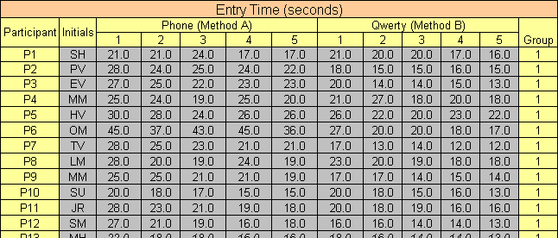
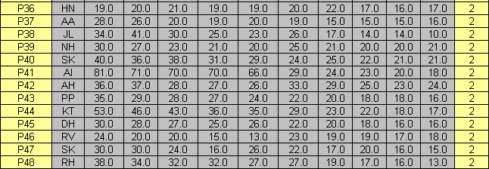
Observe
Measure
…

Slide 149
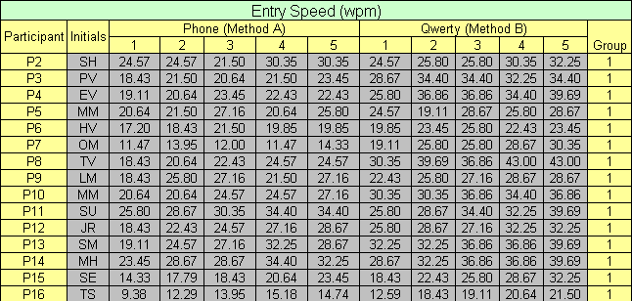
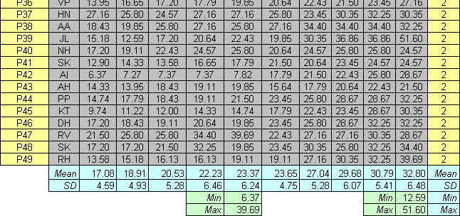
…
Describe
Compare

Slide 150
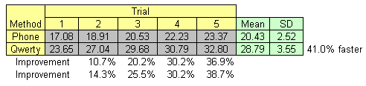
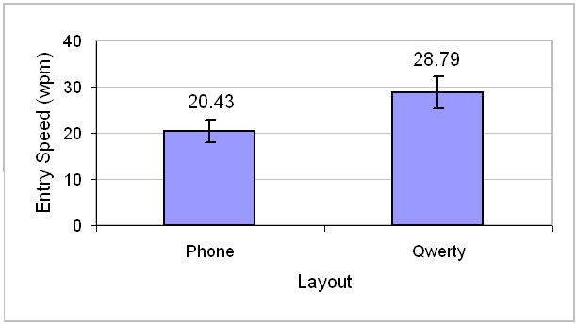

Slide 151
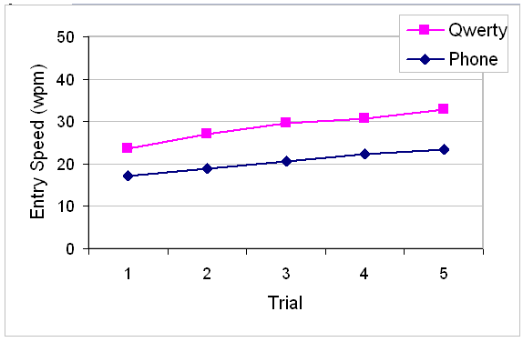
Note: Use bar chart for nominal data (previous slide), line chart for continuous data (above)

Slide 152
Infer
There was a significant effect of keyboard layout on entry speed (F_{1,47} = 131.2, p < .0001).

Slide 153
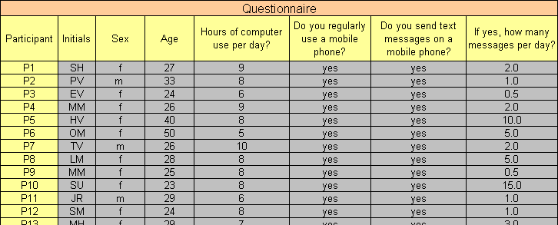
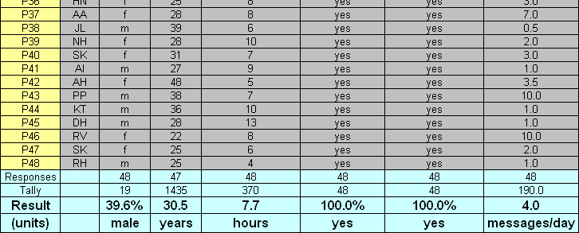
?
Relate
…
Next slide

Slide 154
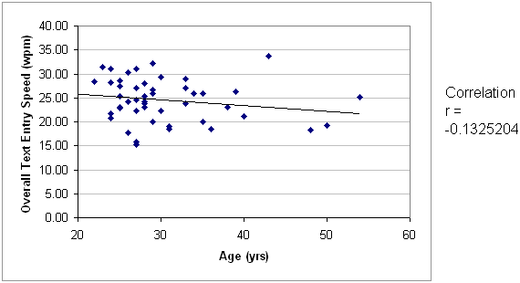
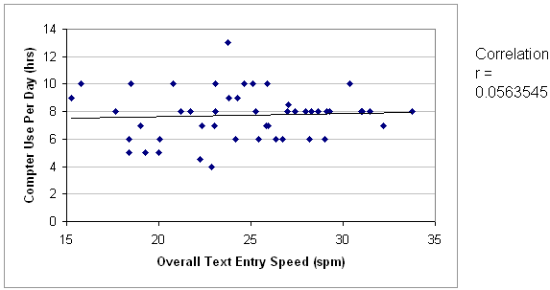

Slide 155
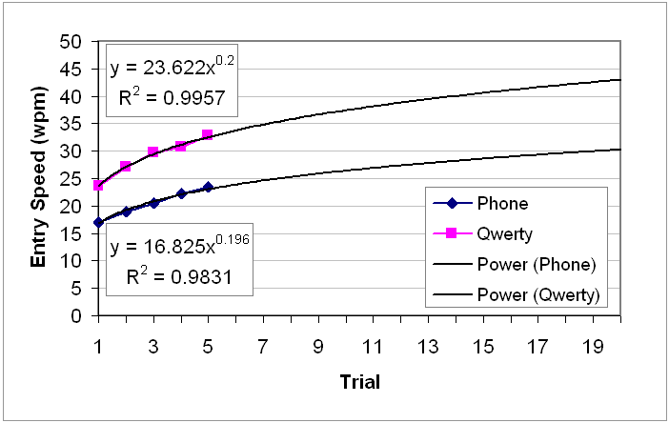
Predict

Slide 156
Statistical Analysis of Performance
Given a set of measurements of a value how certain can we be of the value ?
Given a set of measurements of two values how certain can we be that the values are different ?
Given a measured outcome and several condition or treatment values how can we remove the effect of unwanted conditions or treatments on the outcome ?

Slide 157

What do you want to know?
Univariate numbers
One variable involved
Mean, median, mode, standard deviation, variance
e.g., average home price, number of customers
Bivariate relationships
Two variables involved
To assess differences: Cross tabs & chi square, paired samples t-test (1 group, 2 ?s), independent samples t-test (1 ?, 2 groups)
e.g. are our female customers less loyal than our male customers?
To assess association: correlation, simple regression
Multivariate relationships
Simultaneous analysis of more than 2 variables
ANOVA, multiple regression
e.g. What is the largest predictor of purchasing: age, sex, or income?

Slide 158
Univariate statistics
Nominal measures --
Percentages
easy to compare
divide the # of measurements < or > threshold or in different categories of measurements by the total
for example 15 of 60 = 25%

Slide 159
Eg: What is the true CPU cost of this computation ?
Make a number of measurements of the CPU time required to compute
Before doing any calculations with the data always visualize your data
Histogram
Kernel Density Estimate
places a small normal distribution, the kernel, at each observed data point and sums them up
look at frequency distributions
number of measurements
how many missing values?
consistent with the measurement categories?
make sure there are no “unreasonable” answers
includes the full range?
e.g, all the numbers in a 1 to 7 scale

Slide 160
Univariate statistics
Continuous measures
Mean
average
Median
middle of the range
Mode
most frequent measurement

Slide 161
Selecting a Statistic

Slide 162
Eg: Sample Mean of CPU cost
Based on the visualization it is reasonable to compute the mean of this distribution
But how confident can we be that this is the true value ?
We would like to have a confidence interval that would tell us the following
If we drew random samples of size n and took the mean of the cpu time, 95% of the time the mean would lie between a lower bound and an upper bound

Slide 163
Confidence Intervals Via Resampling
Using a computer we can simulate this
We draw 1000 random subsamples (with replacement) from our original n points and compute the mean
Then we sort these means and choose the 26th and 975th values as our lower and upper bounds
Results: In 950 trials out of 1000, 2.4 <= mean <= 2.5

Slide 164
Bootstrapping on the Median
Suppose our goal was to measure the median CPU time required for this computation rather than the average
We would like to know that of the time the observed median is within some bound of the true median
We can still apply the bootstrap method
Choose 1000 random samples with replacement of size from our n original points
Take the median value of each sample
Sort and take the value at the 25th and 975th positions
The bootstrap is good for the mean the median and other statistics involving the middle of a distribution
The bootstrap is not good for estimating the minimum, the maximum or other statistics involving the tails of the distribution

Slide 165
Measuring Number of Occurrences of Events
In many CS experiments we count the number of events that occur in n trials
For example in machine learning suppose we constructed a decision tree and then evaluated it on a test set of 100 examples and observed correct 78 classifications
We would report the proportion of correctly classified test examples as 0.78
But how uncertain is this quantity? How much might it vary due to the random choice of the test set ?
We will say θ = 0.78 where θ is the true proportion of correct classifications that our decision tree would make on an infinite test set
ˆ

Slide 166
A Bootstrap Confidence Interval
We can again perform a bootstrapping experiment
Let n be number of test examples
Repeat 1000 trials
Draw a random sample of size n with replacement from the test set
Measure p_{i} = the proportion correctly classified by the decision tree
Sort the p_{i} in increasing order
Choose lb and ub to be the 26th and 975th elements
Then we would say in 1000 trials, the probability is 0.95 that we would observe lb <= Ǿ <= ub
Results: 0.81 <= Ǿ <= 0.94 with confidence 0.95
What if not normally distributed ? Eg. : Binomial distribution ?

Slide 167
Comparing Two Measurements
Say we performed trials of the computation using another algorithm and obtained n data of cpu time
Can we conclude that this algorithm is faster than the previous if the mean is smaller ?
Visualizing
Compare kernel density estimation plots

Slide 168
Bootstrap Test
Conduct 1000 trials of the following
Draw bootstrap sample from algo. A, compute mean x_{A}
Draw bootstrap sample from algo. B, compute mean x_{B}
Count number of times x_{A} > x_{B}
If this is greater 950, then out of 1000 trials, we can be 95% confident algo. A slower than algo. B
We can also compute a bootstrap confidence interval on the difference x_{A} - x_{B}
out of 1000 trials, we can be 95% confident that 0.0461 <= x_{A} - x_{B} <= 0.0533

Slide 169
Common Mistakes
Poor gold-standards or Corpus
Test your training data
Cross-validation
Boot-strapping
Poor baselines
Correlation not causation
Significance tests

Slide 170

Church spotter 1

Slide 171

Church spotter 2

Slide 172

Church spotter 3

Slide 173

Church spotter 4

Slide 174
Church spotter
If you see a building and it’s white
It’s a church

Slide 175




Test this
If you see a building and it’s white
It’s a church
75%

Slide 176
Correlation, causation?
Correlation
women taking combined hormone replacement therapy (HRT) had a lower-than-average coronary heart disease
HRT reduces heart disease? (causation)
No
women undertaking HRT were more likely to be from higher socio-economic groups with better than average diet and exercise regimes

Slide 177
Significance
Comparing IR systems
System a – 0.28
System b – 0.32
System c – 0.37

Slide 178
Examine a & b
System a – 0.28
System b – 0.32

Slide 179
Examine b & c
System b – 0.32
System c – 0.37

Slide 180
Cross-validation
statistical practice of partitioning a sample of data into subsets such that the analysis is initially performed on a single subset, while the other subset(s) are retained for subsequent use in confirming and validating the initial analysis.
The initial subset of data is called the training set; the other subset(s) are called validation or testing sets.

Slide 181
Common types of cross-validation
Holdout validation
Observations are chosen randomly from the initial sample to form the validation data, and the remaining observations are retained as the training data. Normally, less than a third of the initial sample is used for validation data
K-fold cross-validation
Original sample is partitioned into K subsamples. Of the K subsamples, a single subsample is retained as the validation data for testing the model, and the remaining K − 1 subsamples are used as training data.
The cross-validation process is then repeated K times (the folds), with each of the K subsamples used exactly once as the validation data.
The K results from the folds then can be averaged (or otherwise combined) to produce a single estimation.
Leave-one-out cross-validation
involves using a single observation from the original sample as the validation data, and the remaining observations as the training data. This is repeated such that each observation in the sample is used once as the validation data. This is the same as K-fold cross-validation where K is equal to the number of observations in the original sample.

Slide 182

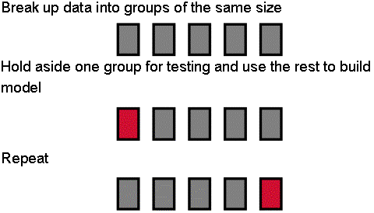
k-Fold Cross-Validation
Experiments were repeated 10 times:
fine-tune the algorithm on nine folds such that better precision and recall could be obtained, and remaining fold was used to report the result.
Same folds were used across all algorithms and experiments
Idea Plagiarism Screening – PhD Viva | Salha Alzahrani, 2012 | 182

Slide 183
Analysis of Variance
It is interesting that the test is called an analysis of variance, yet it is used to determine if there is a significant difference between the means.
How is this?

Slide 184
Example #1 Example #2
Difference is significant
Difference is not significant
“Significant” implies that in all likelihood the difference observed is due to the test conditions (Method A vs. Method B).
“Not significant” implies that the difference observed is likely due to chance.
Notes:
File: AnovaDemo.xls

Slide 185
Example #1 - Details
Error bars show
±1 standard deviation
Note: SD is the square root of the variance

Slide 186
Binary or categorical outcomes (proportions)
Outcome Variable | Are the observations correlated? |  | Alternative to the chi-square test if sparse cells:
 | independent | correlated
Binary or categorical (e.g. fracture, yes/no) | Chi-square test: compares proportions between two or more groups Relative risks: odds ratios or risk ratios Logistic regression: multivariate technique used when outcome is binary; gives multivariate-adjusted odds ratios | McNemar’s chi-square test: compares binary outcome between correlated groups (e.g., before and after) Conditional logistic regression: multivariate regression technique for a binary outcome when groups are correlated (e.g., matched data) GEE modeling: multivariate regression technique for a binary outcome when groups are correlated (e.g., repeated measures) | Fisher’s exact test: compares proportions between independent groups when there are sparse data (some cells <5). McNemar’s exact test: compares proportions between correlated groups when there are sparse data (some cells <5).

Slide 187
Binary or categorical outcomes (proportions)
Outcome Variable | Are the observations correlated? |  | Alternative to the chi-square test if sparse cells:
 | independent | correlated
Binary or categorical (e.g. fracture, yes/no) | Chi-square test: compares proportions between two or more groups Relative risks: odds ratios or risk ratios Logistic regression: multivariate technique used when outcome is binary; gives multivariate-adjusted odds ratios | McNemar’s chi-square test: compares binary outcome between correlated groups (e.g., before and after) Conditional logistic regression: multivariate regression technique for a binary outcome when groups are correlated (e.g., matched data) GEE modeling: multivariate regression technique for a binary outcome when groups are correlated (e.g., repeated measures) | Fisher’s exact test: compares proportions between independent groups when there are sparse data (some cells <5). McNemar’s exact test: compares proportions between correlated groups when there are sparse data (some cells <5).
no relation between groups, e.g., people randomly assigned to a single group.

Slide 188
Binary or categorical outcomes (proportions)
Outcome Variable | Are the observations correlated? |  | Alternative to the chi-square test if sparse cells:
 | independent | correlated
Binary or categorical (e.g. fracture, yes/no) | Chi-square test: compares proportions between two or more groups Relative risks: odds ratios or risk ratios Logistic regression: multivariate technique used when outcome is binary; gives multivariate-adjusted odds ratios | McNemar’s chi-square test: compares binary outcome between correlated groups (e.g., before and after) Conditional logistic regression: multivariate regression technique for a binary outcome when groups are correlated (e.g., matched data) GEE modeling: multivariate regression technique for a binary outcome when groups are correlated (e.g., repeated measures) | Fisher’s exact test: compares proportions between independent groups when there are sparse data (some cells <5). McNemar’s exact test: compares proportions between correlated groups when there are sparse data (some cells <5).
Either same people in both groups, or people are related, e.g., husband-wife, left hand-right hand, hospital patient and visitor

Slide 189
Continuous outcome (means)
Outcome Variable | Are the observations independent or correlated? |  | Alternatives if the normality assumption is violated (and small sample size):
 | independent | correlated
Continuous (e.g. pain scale, cognitive function) | Ttest: compares means between two independent groups ANOVA: compares means between more than two independent groups Pearson’s correlation coefficient (linear correlation): shows linear correlation between two continuous variables Linear regression: multivariate regression technique used when the outcome is continuous; gives slopes | Paired ttest: compares means between two related groups (e.g., the same subjects before and after) Repeated-measures ANOVA: compares changes over time in the means of two or more groups (repeated measurements) Mixed models/GEE modeling: multivariate regression techniques to compare changes over time between two or more groups; gives rate of change over time | Non-parametric statistics Wilcoxon sign-rank test: non-parametric alternative to the paired ttest Wilcoxon sum-rank test (=Mann-Whitney U test): non-parametric alternative to the ttest Kruskal-Wallis test: non-parametric alternative to ANOVA Spearman rank correlation coefficient: non-parametric alternative to Pearson’s correlation coefficient

Slide 190
Statistical Significance Analysis
Depended-Sample Paired t-test (Leech et al., 2008):
true mean difference of two algorithms null hypothesis: algorithms perform equivalently (i.e., the true mean difference is zero)
null hypothesis: “algorithm A & B have no significant difference and perform equally”.
ANalysis Of VAriance (ANOVA) (Leech et al., 2008)
generalises t-test in a way that examines whether or not the means of several algorithms are equivalent
null hypothesis that “All algorithms perform comparably”
Idea Plagiarism Screening – PhD Viva | Salha Alzahrani, 2012 | 190

Slide 191
Wilcoxon signed-rank test
A non-parametric statistical hypothesis test used when comparing two related samples, matched samples, or repeated measurements on a single sample to assess whether their population mean ranks differ (i.e. it is a paired difference test). It can be used as an alternative to the paired Student's t-test, t-test for matched pairs, or the t-test for dependent samples when the population cannot be assumed to be normally distributed

Slide 192
Example #1 - Anova
Probability that the difference in the means is due to chance
Thresholds for “p”
.05
.01
.005
.001
.0005
.0001
Reported as…
F_{1,9} = 8.443, p < .05
Notes:
File: AnovaExample1.svd

Slide 193
How to Report an F-statistic
There was a significant main effect of input method on entry speed (F_{1,9} = 8.44, p < .05).
Notice in the parentheses
Uppercase for F
Lowercase for p
Italics for F and p
Space both sides of equal signn
Space after comma
Space both sides of less than sign
Degrees of freedom are subscript, plain, smaller font
Three significant figures for F statistic
No zero before the decimal point in the p statistic (except in Europe)

Slide 194
Example #2 - Details
Error bars show
±1 standard deviation

Slide 195
Example #2 – Anova
Probability that the difference in the means is due to chance
Note: For non- significant effects, use “ns” if F < 1.0, or “p > .05” if F > 1.0.
Reported as…
F_{1,9} = 0.634, ns
Notes:
File: AnovaExample2.svd

Slide 196
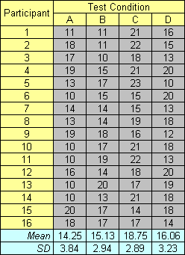
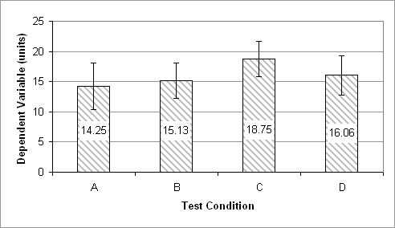
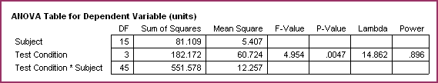
More Than Two Test Conditions
Note: For non- significant effects, use “ns” if F < 1.0, or “p > .05” if F > 1.0.

Slide 197
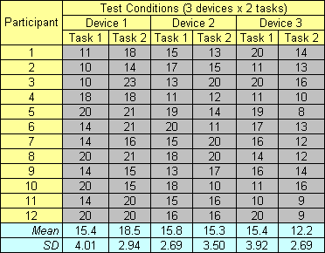
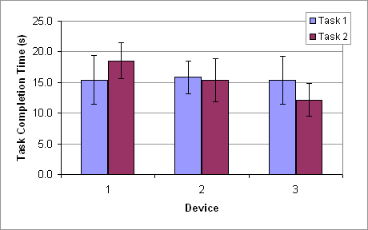
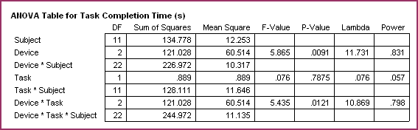
Two Factors
Note: For non- significant effects, use “ns” if F < 1.0, or “p > .05” if F > 1.0.

Slide 198
Evaluating Evidence Of Validity & Reliability
Is there strong evidence that this instrument measures the variable I am studying?
What procedures did the researcher use to determine that all relevant aspects of the construct were measured by the instrument?
An instrument may measure only one dimension of the domain; multiple measures may be necessary to measure more of the concept.
Is there evidence that the instrument measures the variable consistently?
If the instrument is a questionaire that must be read by research subjects, is the readability level reported? What information about the reading comprehension level of the sample is provided?
Is there evidence that this instrument is appropriate for my sample and setting?
Many instruments developed by researchers in other disciplines have been used in cs studies. Often, little attention has been given to the appropriateness of these instruments for the populations likely to be studied by CS researchers.
Many research instruments are too lengthy and difficult to manage for use in CS settings.

Slide 199
The Nature of Good Design
Theory-Grounded.
Good research strategies reflect the theories which are being investigated
Eg: where theory predicts a specific treatment effect on one measure but not on another, the inclusion of both in the design improves discriminant validity and demonstrates the predictive power of the theory.
Situational.
Good research designs reflect the settings of the investigation
Eg: intergroup rivalry, demoralization, and competition might be assessed through the use of additional comparison groups who are not in direct contact with the original group.
Feasible.
Good designs can be implemented.
The sequence and timing of events are carefully thought out.
Potential problems in measurement, adherence to assignment, database construction and the like, are anticipated. Where needed, additional groups or measurements are included in the design to explicitly correct for such problems.
Redundant.
Good research designs have some flexibility built into them.
Often, this flexibility results from duplication of essential design features.
Eg.: multiple replications of a treatment help to insure that failure to implement the treatment in one setting will not invalidate the entire study.
Efficient.
Good designs strike a balance between redundancy and the tendency to overdesign. Where it is reasonable, other, less costly, strategies for ruling out potential threats to validity are utilized.

Slide 200
Is the research described clearly enough that others can reproduce it?
You can’t include everything
Have they included enough of what is important?
Have they included too much of what is unimportant?

Slide 201
Is the research methodology valid?
Are the research methods described clearly? Do they make sense?
What are the assumptions? There are always assumptions…
How sensitive are the results to the assumptions?
If the assumptions are slightly wrong, are the results invalid?

Slide 202
Is the research correct?
Are the formulas / algorithms / statistical methods correct?
Do the experiments test what the student says they test?
Have boundary conditions been explored?
Do the results make sense, and is it clear why they were obtained?

Slide 203
Is the analysis correct?
Do the results support the conclusions?
Do they support different, competing conclusions?

Slide 204
Threats to validity — Examples (1/2)
Construct validity
Do the operational measures reflect what the researcher had in mind ?
Time recorded vs. time spent
Execution time, memory consumption, …
+ noise of operating system, sampling method
Human-assigned classifiers (bug severity….)
+ risk for “default” values
Participants in interviews have pressure to answer positively
Internal validity
Are there any other factors that may affect the results ?
Were phenomena observed under special conditions
+ in the lab, close to a deadline, company risked bankruptcy, …
+ major turnover in team, contributors changed (open-source…)
Similar observations repeated over time (learning effects)

Slide 205
Threats to validity — Examples (2/2)
External validity
To what extent can the findings be generalized ?
Does it apply to other languages ? other sizes ? other domains ?
Background & education of participants
Simplicity & scale of the team
+ small teams & flexible roles vs. large organizations & fixed roles
Reliability
To what extent is the data and the analysis dependent on the researcher (the instruments, …)
How did you cope with bugs in the tool, the instrument ?
Classification: if others were to classify, would they obtain the same ?
How did you search for evidence in mailing archives, bug reports, …

Slide 206
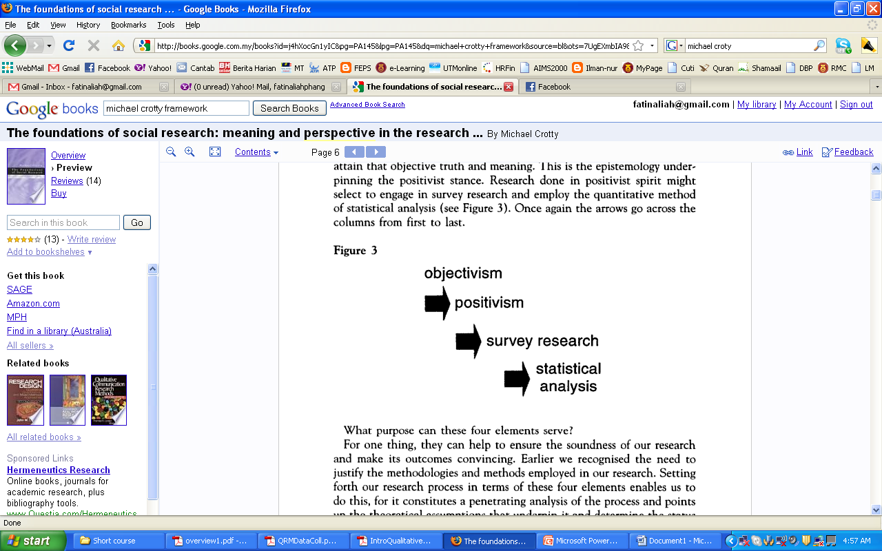
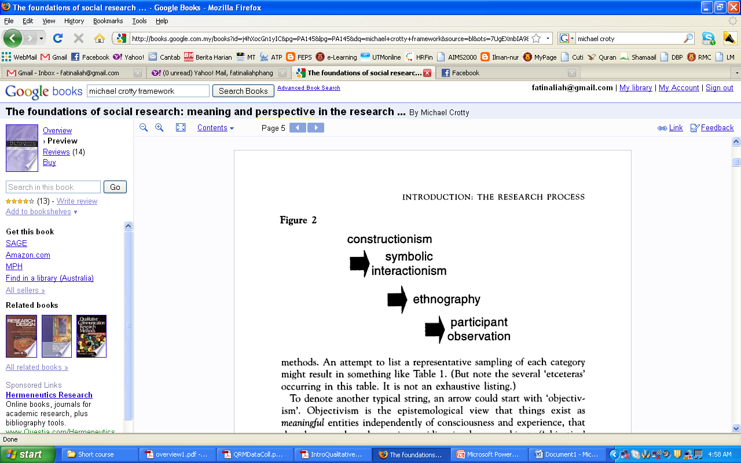
(Crotty, 1998:5-6)

Slide 207
Research Design (Ranjit Kumar, Research Methodology: A Step-By-Step Guide for Beginners, 1999)
A research design is a plan, structure and strategy of investigation so conceived as to obtain answers to research questions or problems.
2 main functions of research design:
Conceptualize an operational plan to undertake the various procedures and tasks required to complete the study
Ensure that these procedures are adequate to obtain valid, objective and accurate answers to the research questions.

Slide 208
Research Design
Research design is a blueprint of research.
It deals with at least 4 problems:
What question to study
What data are relevant
What data to collect
How to analyze the results

Slide 209
Draw Up a Research Framework
Phase | Activities | Resources Needed | Benchmark Data | Baselines for Comparison | Perfor-mance Evaluation | Objectives Addressed
Diagram
Table
Description
Gantt Chart

Slide 210
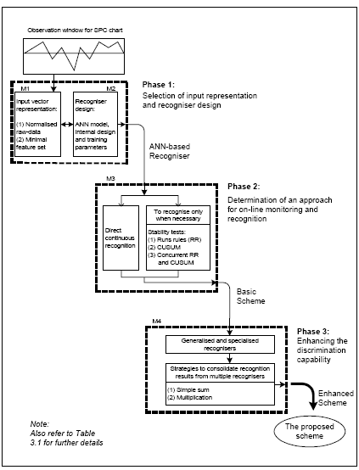
Example 1: Research Design
Phase | Objective
1 | To develop an on-line recognition scheme that can perform timely and accurate recognition of CCPs even as they are developing
2 | To develop improved recognisers that can perform accurate classification of partially developed CCPs. In particular, this research focuses on improving input representation and design of the ANN-based recognisers.

Slide 211
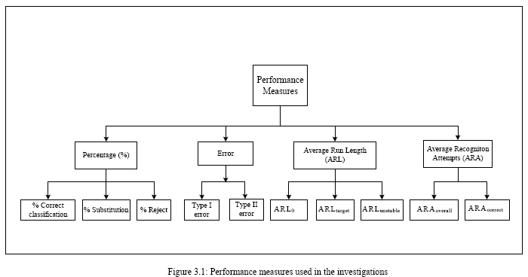
Performance Measures

Slide 212
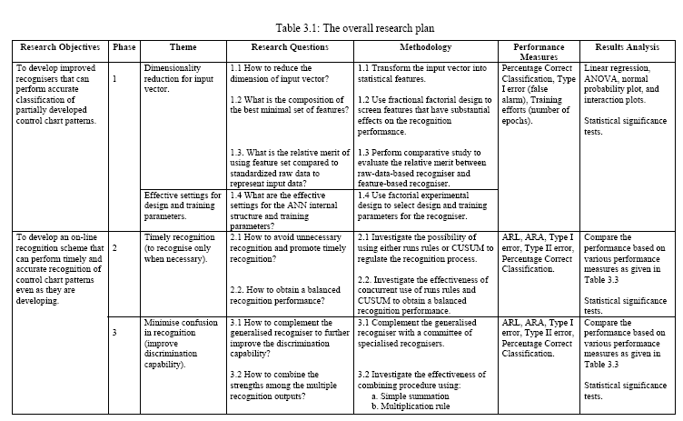
Example 2: Research Design

Slide 213
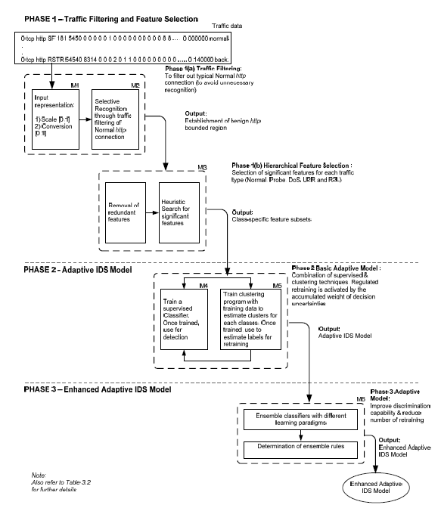
Example 3 of Research Design (A.Zainal,IDS)
To improve the effectiveness of pre-detection stage by designing procedures for minimizing unnecessary recognition and selectively choose the network connection.
To design and develop IDS model that can adaptively learn the dynamic circumstances in the network traffic and regularly update the reference model to reflect the changes
To improve discriminative capability of the IDS model to deal with vague boundary between normal and abnormal traffic pattern and on imbalanced dataset. Inparticular this research investigates on the design of classifiers by the means of ensemble classifier.
ii)

Slide 214
Example 4: Research Framework (Software Watermarking – Master Project)
PHASE 1 – Analysis of Software Watermarking Algorithm
Analyze existing algorithms
Classify pros and cons of tested algorithm
Phase 1 Analysis of static watermarking algorithm
To identify pros and cons of tested algorithm
Output:
Results and classification of potential software watermarking algorithm
Problem Identification – Identify problem that is not stated in the paper
PHASE 2 – Watermark Encoding and Dummy Method Development
Watermark character sequences
Produce fixed size of bit sequences
Phase 2 (a) Watermark’s Encoding Procedure
To produce a fixed bit sequences by hashing the watermark characters.
Apply Hash
Output:
Fixed size of watermark bit sequences
Phase 2 (b) Multiple Dummy Method Creation
Prepare several dummy methods to reduce watermark visibility detection.
Create different Dummy Method’s code representation
Loop
Output:
Multiple Dummy Method
To analyze existing technique in software watermarking
ii) To design and implement an encoding scheme for watermark to be embedded in software.
iii) To enhance a watermarking technique that is less noticeable to attacker
PHASE 3 – Random Dummy Method Insertion Technique and Recognition
Select one of dummy method randomly and inject into class file
Phase 3(a) Dummy Method and Watermark Insertion
Embed bit sequences by replacing opcodes and overwriting numerical operands in dummy method.
Embed watermark in dummy method within the class file
Output:
Random Dummy Method insertion and embedded watermark
Phase 3(b) Comparison between claimed and extracted watermark
To identify which watermark is originally embedded into class file
Watermark character
sequences
Extract watermark from class file
Output:
Message verification whether the claimed watermark has same message digest as extracted watermark from class file
Compared message digest for both of claimed and extracted watermark
Fixed Size Encoding and Random Dummy Method Insertion Technique

Slide 215
THANK YOU

